Slide 1
Growing Healthy Families Module 1: Physical Activity in Your Family

Slide 2
Objectives
Module 1 | Growing Healthy Families: Being Active
Explore how much physical activity we incorporate into our lives
Develop ideas for physical activity in our everyday lives
Identify places where we can go outside of our homes for physical activity
Introduce the Family Activity Chart

Slide 3
Did You Know?
Module 1 | Growing Healthy Families: Being Active
Only 5% of Americans do vigorous activity on a given day. (Tudor-Locke, Johnson, Katzman, 2010)
2% of children ages 6-11 yrs. get the recommended 60 minutes a day of physical activity.
8% of adolescents get the recommended 60 minutes a day of physical activity.

Slide 4
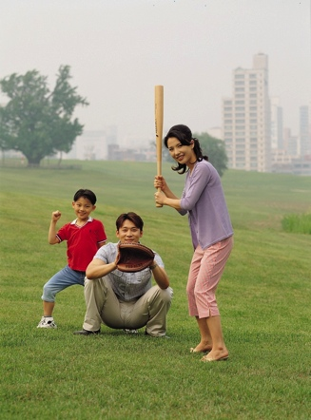
Did You Know?
Module 1 | Growing Healthy Families: Being Active
Only 5% of adults get the recommended 30 minutes a day of physical activity. (Troiano, Berrigan, Dodd, Mâsse, Tilert , McDowell, 2010)
70% of Americans do not get the amount of physical activity they need.

Slide 5
Family Activity Chart
Module 1 | Growing Healthy Families: Being Active
Put it on your refrigerator then everyone in the family can participate, even adults.
Complete 15 minutes of physical activity to write your name.
Put family activities on top.
Plan a special non-food prize for each family activity.
Good prizes for children:
time with parent, game

Slide 6
Physical Activity Skills
Module 1 | Growing Healthy Families: Being Active
You are not born with these skills…you learn them.
Practice does make a difference.
Adults can improve skills by practice too.
There are stages to learning every physical activity.
Example: Running

Slide 7
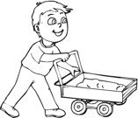
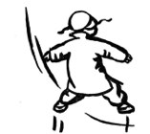
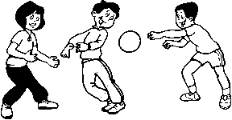
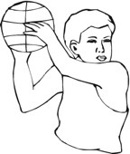
Activity Skills
Module 1 | Growing Healthy Families: Being Active
Movement
Walking
Running
Jumping
Skipping
Leaping
Chasing
Object Control
Kicking
Hitting
Punting
Swimming
Volleying
Receiving
Catching
Biking
Climbing
Throwing (Overhand & Underhand)
Punting

Slide 8
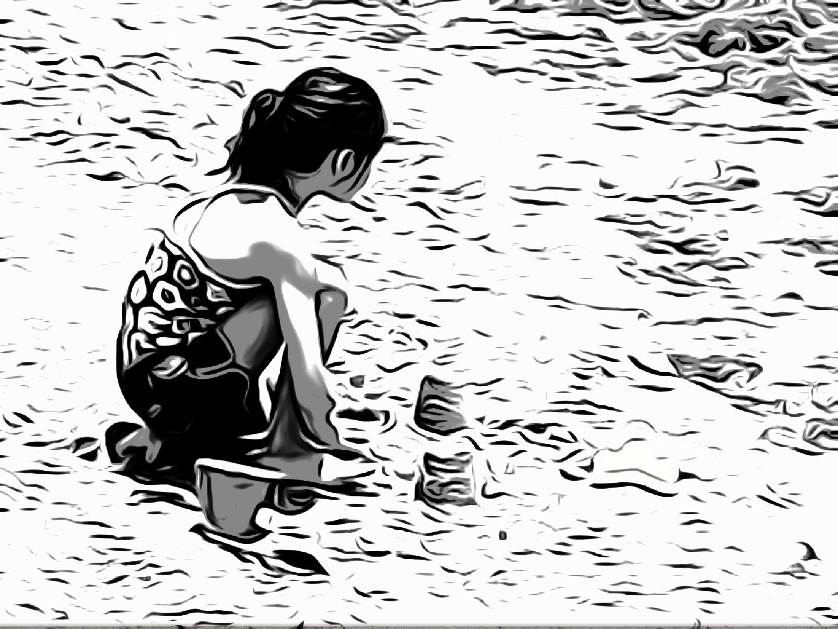
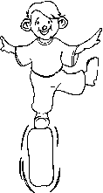
Activity Skills
Module 1 | Growing Healthy Families: Being Active
Stability
Bending
Stretching
Twisting & Turning
Swinging
Dodging
Balancing
Shaking
Rolling
Pushing & Pulling
Swaying
Galloping
Hopping
Sliding
Stopping

Slide 9
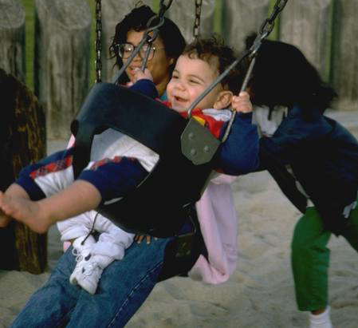
Summary
Module 1 | Growing Healthy Families: Being Active
We explored how much physical
activity we incorporate into our lives.
We developed ideas for physical
activity in our everyday lives and
in our homes, using items around the house.
We identified places where we can go outside our homes for physical activity.

Slide 10
The following 2 slides are optional and are used with the pedometer activity.

Slide 11
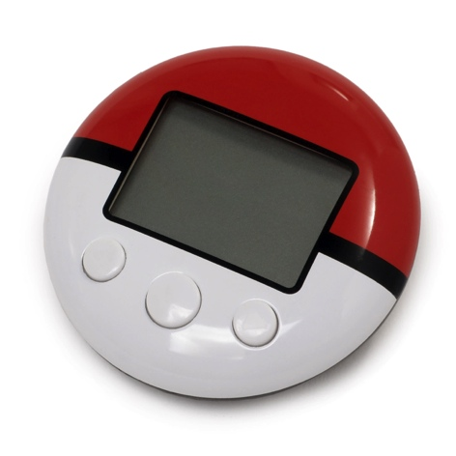
Pedometer
Module 1 | Growing Healthy Families: Being Active
A pedometer is a small device, usually worn on a shoe or the waist, that measures the number of steps you take.
2000 steps = 20 minutes or about 1 mile.
Increase your walking each day by 200-500 steps until you are walking 10,000 steps a day!
10,000 steps is optimal for fitness!

Slide 12
How to Use a Pedometer
Module 1 | Growing Healthy Families: Being Active
People who use pedometers or fitness trackers increase the number of steps they take and tend to lose weight!
Place the pedometer on your belt or waistband above your hip or directly over your knee.
Be sure that it fits snugly to your belt and is upright, not tilted.
Walk 50 steps – using your normal walking stride – to see how accurate it is. It should show 50 steps plus or minus a few.
If it is off by more than 5-6 steps, try moving it over and then check again.
Put it on first thing in the morning and take it off when you go to bed. Record how many steps you take each day!

